Slide 1
Embedded Lab - 1 Tiva C Series TM4C123GH6PM Port Initialization

Slide 2
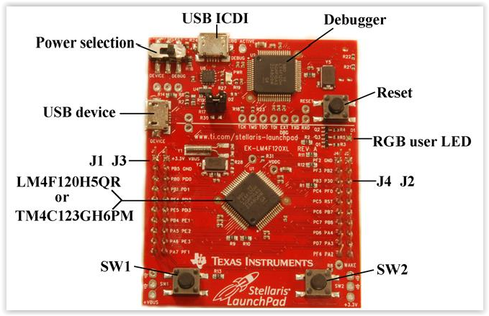
TIVA TM4C123G LaunchPad
32-bit ARM® Cortex™-M4
System clock frequency up to 80 MHz
E-book Link: http://users.ece.utexas.edu/~valvano/Volume1/E-Book/

Slide 3
Port Initialization for GPIO usage
// Making PA2 an output
void port_Init(void)
{
volatile unsigned long delay;
SYSCTL_RCGC2_R |= 0x01; // activate clock for Port A
delay = SYSCTL_RCGC2_R; // allow time for clock to start
GPIO_PORTA_PCTL_R &= ~0x0000000F; // regular GPIO
GPIO_PORTA_AMSEL_R &= ~0x04; // disable analog function on PA2
GPIO_PORTA_DIR_R |= 0x04; // set direction to output
GPIO_PORTA_AFSEL_R &= ~0x04; // regular port function
GPIO_PORTA_DEN_R |= 0x04; // enable digital port
}

Slide 4
Port Initialization for GPIO usage
Doubted : Lab 31 Jan 2018
// Making PD3, PD0 an output
void PortD_Init(void)
{
volatile unsigned long delay;
SYSCTL_RCGC2_R |= 0x00000008; // 1) activate clock for Port D
delay = SYSCTL_RCGC2_R; // allow time for clock to start
// only PF0 needs to be unlocked, other bits can't be locked
GPIO_PORTD_AMSEL_R &= ~0x00; // 3) disable analog on PD
GPIO_PORTD_PCTL_R = 0x00000000;// 4) PCTL GPIO on PD
GPIO_PORTD_DIR_R |= 0x09; // 5) PD30, PD3 as output
GPIO_PORTD_AFSEL_R &= ~0x09; // 6) disable alt funct on PD0, PD3
GPIO_PORTD_DEN_R = 0x09; // 7) enable digital I/O on PD0, PD3
}

Slide 5
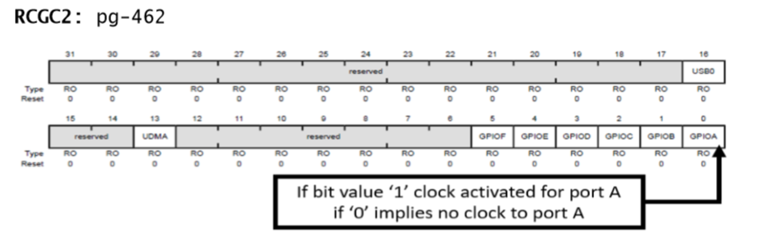
System Control Run mode Clock Gating Control 2 (SYSCTL_RCG2)

Slide 6
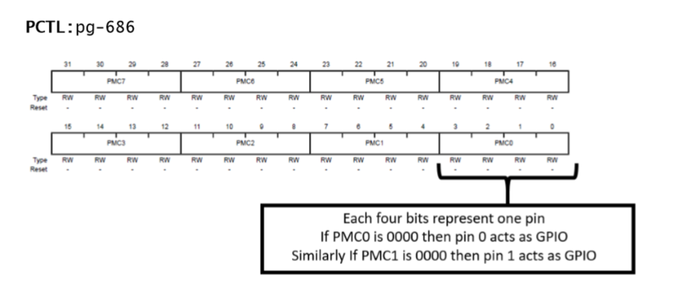
PCTL

Slide 7
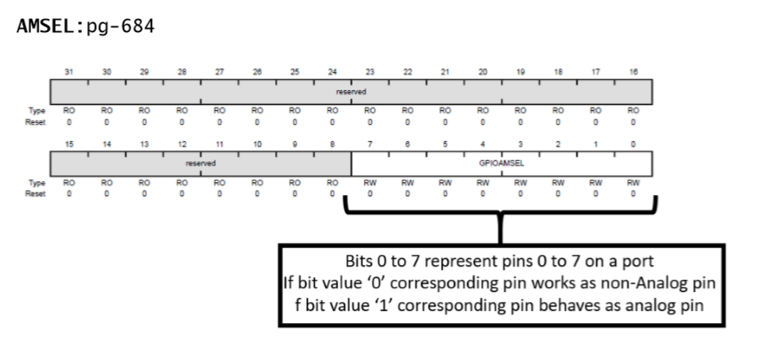
AMSEL

Slide 8
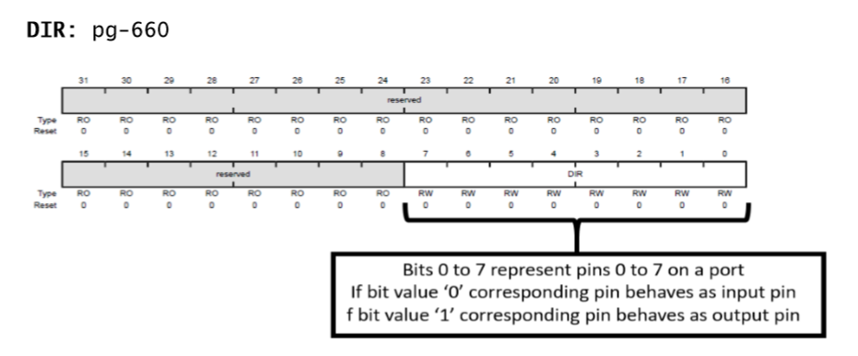
DIR
We set the direction register (e.g., GPIO_PORTF_DIR_R) to specify which pins are input and which are output.

Slide 9
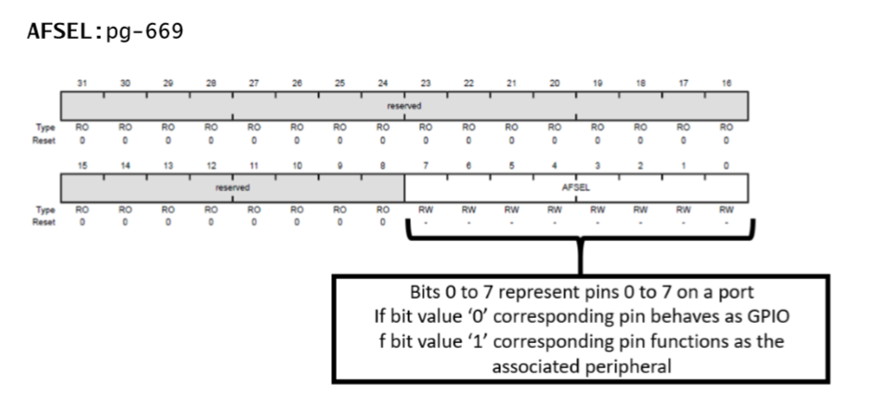
AFSEL
Individual port pins can be general purpose I/O (GPIO) or have an alternate function. We set bits in the alternate function register (e.g., GPIO_PORTF_AFSEL_R) when we wish to activate the alternate functions.

Slide 10
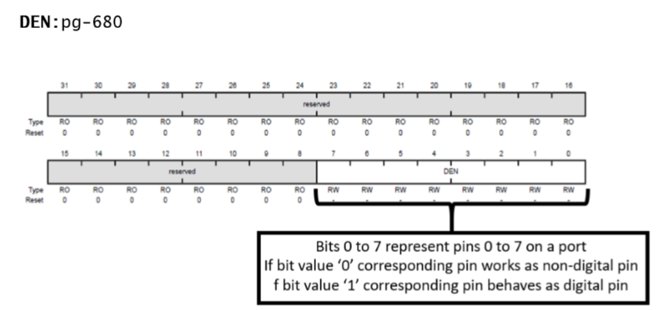
DEN
For each I/O pin we wish to use whether GPIO or alternate function, we must enable the digital circuits by setting the bit in the enable register (e.g., GPIO_PORTF_DEN_R).

Slide 11
Basic Bit-wise Operations for Register Access
OR |
E.g., REG |= 0x08
Means, REG = REG | 0x08. Sets bit 3 (0x08h= 1000 binary) to 1 without changing the other bits. Handy to set to 1 just the bits you want
AND &
E.g., REG &= ~( 0x08)
Means, REG = REG & ~(0x08) = REG & ~(0000 1000) = REG & (1111 0111). Sets bit 3 to 1 without changing the other bits. Handy to set to 0 (clear) just the bits you want

Slide 12
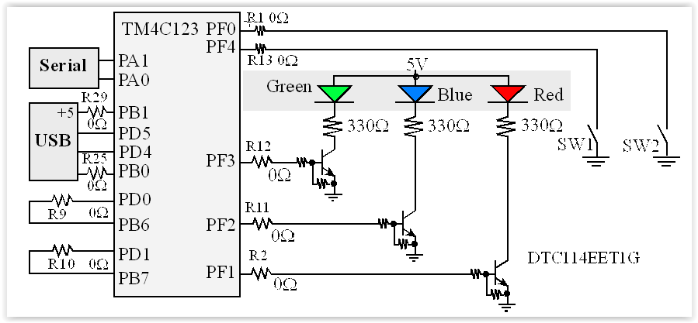
Switch and LED interface

Slide 13
Port F intialization
void PortF_Init(void)
{
volatile unsigned long delay;
SYSCTL_RCGC2_R |= 0x00000020; // 1) activate clock for Port F
delay = SYSCTL_RCGC2_R; // allow time for clock to start
GPIO_PORTF_LOCK_R = 0x4C4F434B; // 2) unlock GPIO Port F
GPIO_PORTF_CR_R = 0x1F; // allow changes to PF4-0
// only PF0 needs to be unlocked, other bits can't be locked
GPIO_PORTF_AMSEL_R = 0x00; // 3) disable analog on PF
GPIO_PORTF_PCTL_R = 0x00000000; // 4) PCTL GPIO on PF4-0
GPIO_PORTF_DIR_R = 0x0E; // 5) PF4,PF0 in, PF3-1 out
GPIO_PORTF_AFSEL_R = 0x00; // 6) disable alt funct on PF7-0
GPIO_PORTF_PUR_R = 0x11; // enable pull-up on PF0 and PF4
GPIO_PORTF_DEN_R = 0x1F; // 7) enable digital I/O on PF4-0
}

